Slide 1
Latin American Revolution & Napoleon

Slide 2
First 10

Slide 3
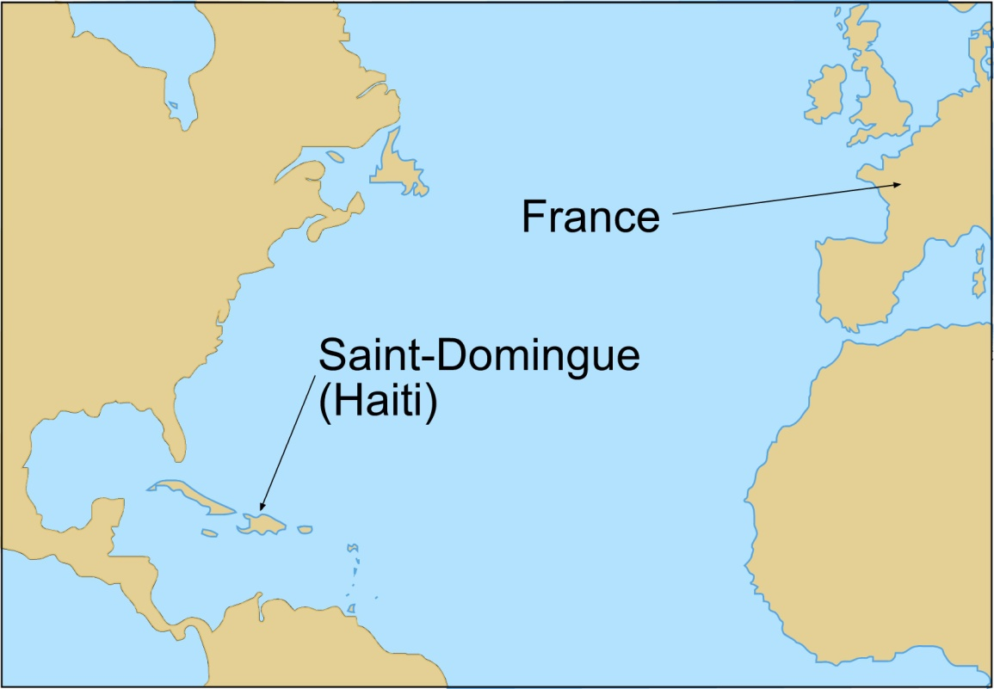
Haitian Revolution- causes
Haiti (Saint Domingue), was a French colony in the Caribbean, which was one of the world’s largest producers of sugar cane
Slaves were brought in to work in the cane fields and outnumbered free people 10 to 1
France is occupied in their own revolution

Slide 4
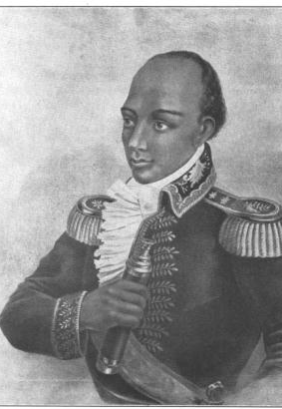
Haitian Revolution
Toussaint L’Ouverture- former slave
Slaves + Mulattoes
Independence won 1798
Napoleon attempted to restore power over Haiti but failed in 1804

Slide 5
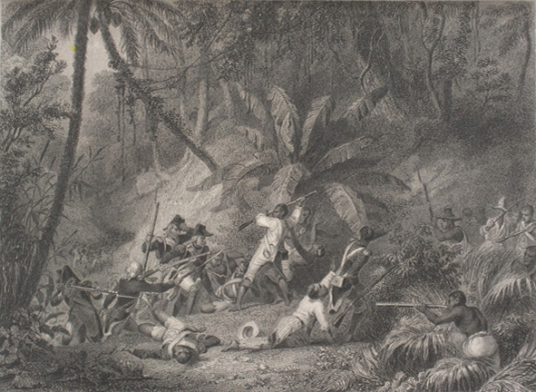
Results of the Haitian Revolution
First successful slave rebellion
Haiti first Latin American country to gain independence from a European power
The loss of Haiti convinced Napoleon to abandon interest in North America and led to the sale of the Louisiana Territory to the U.S. in 1803

Slide 6
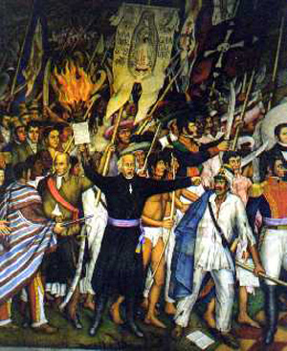
Latin America (1808-1825)- Causes
In 1808, Napoleon conquered Spain, leading to rebellions against Spanish rule in several Latin American countries
No loyalty to the new King
Creoles: educuation, American Rev. & Enlightenment

Slide 7
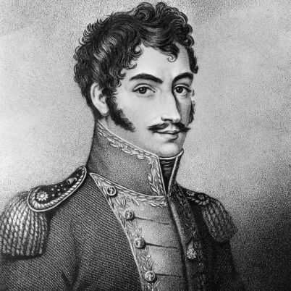
Latin American Revolutions
Simon Bolivar
  “The Liberator” – end Spanish domination in South America
  1810-1822 – Venezuela, Columbia, Ecuador, Peru, and Bolivia
  Joined with Jose de San Martin who defeated the Spanish in Argentina and Chile in 1810s

Slide 8
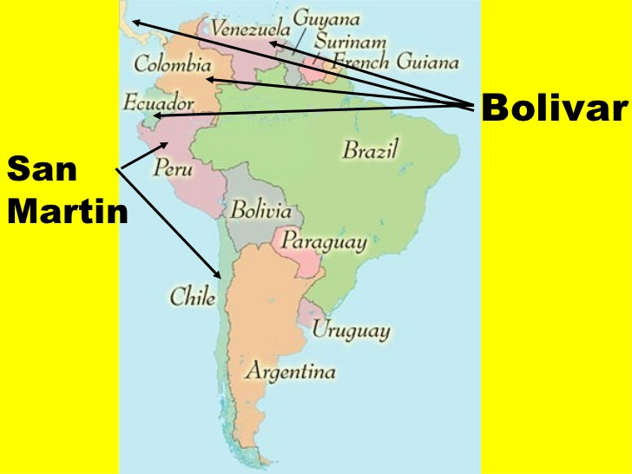

Slide 9
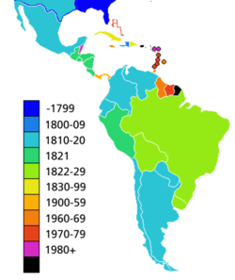
Results of Latin American Revolutions
According to the map, what was the first colony to gain independence? How did this influence other colonies in the Western Hemisphere?
By 1830 many of the Spanish and European colonies had gained independence

Slide 10



Slide 11
Napoleon
Prominent lieutenant in French Army- military genius
won several key victories for France during the 1790s (Austria & Italy)
Napoleon found the post revolutionary Directory in disarray
1799- coup d'état – claimed dictatorship

Slide 12
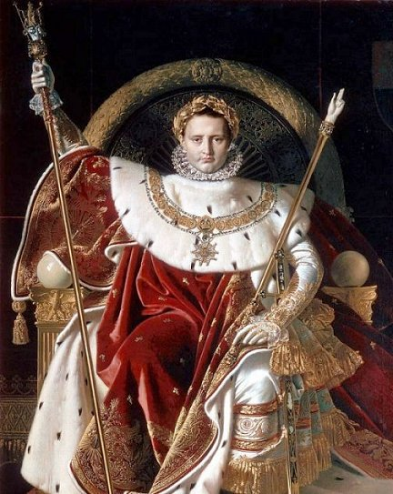
Napoleon
In 1804 crowned Emperor of France
His next move was to expand France’s power throughout the World

Slide 13
Between 1805 and 1813 Napoleon conquered much of Europe
  France, Netherlands, Italy, Switzerland
  Large influence over Russia, Prussia, Austria

Slide 14
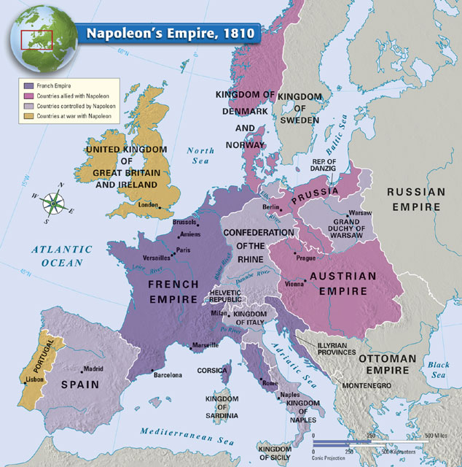

Slide 15

Napoleon’s Achievements
National Banking System
Lycees – Secondary schools
Concordat (Agreement) with Pope Pius VII to restore Catholicism to France
Napoleonic Code – law code to systemize France
  Limited liberty but promoted order and authority (social contract)
Attempted to maintain control over Haiti and New France – not successful
  Sold Louisiana territory to Jefferson (now president) in 1803 for 15 million dollars
  With his sights lost in the New World he turns to try to conquer Britain … doesn’t work
    Only defeat was the Battle of Trafalgar (naval battle lost to GB – had superior navy)

Slide 16
Downfall of Napoleon
3 KEY MISTAKES
  Continental System
  Peninsular war
  Invasion of Russia
April 1814 – Napoleon surrenders – banished to Mediterranean island
March 1815 – Returns to France and people support him
  Defeated at Waterloo – known as Napoleon’s Hundred Days (last 100 days)
    Exiled to South America this time – dies there
    Napoleon

Slide 17
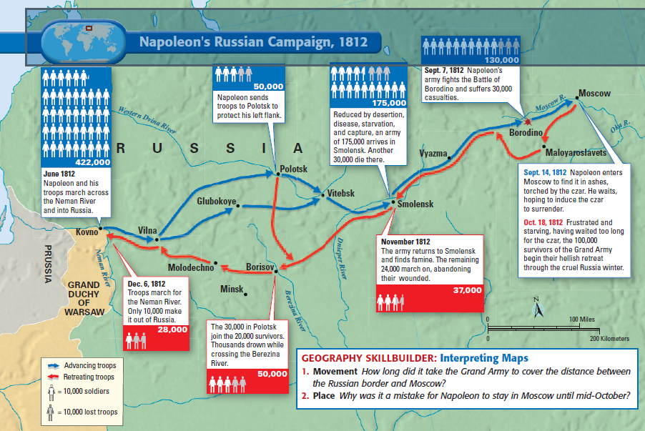

Slide 18
Significance
“Ideas about the basis of power and authority had changed permanently as a result of the French Revolution. More and more, people saw democracy as the best way to ensure equality and justice for all. The French Revolution, then, changed the social attitudes and assumptions that had dominated Europe for centuries. A NEW ERA HAD BEGUN.”
  Pg. 675

Slide 19
Congress of Vienna
1814-15
Goal: New European Order – “one of collective security and stability for the continent”
8 months and 5 superpowers (Russia, Prussia, Austria, Great Britain, and France)
Minister Klemons von Metternich (Austria) emerged as a significant leader at the meetings.
Actions:
  Make small countries around France larger
  Legitimacy – restore families to the throne
Results:
  C. and E. Europe return to Absolutism
  FR and GB will be a constitutional monarchy
  1815 – Holy Alliance between Russia, Prussia, and Austria

Slide 20
