Slide 1
Good morning!
Turn in your Fall of the Roman Empire activity if you did not yesterday.

Slide 2
Religions in Rome
Chapter 6 Section 3

Slide 3
Roman Religion
Romans, like the Greeks, were polytheistic
Augustus brought back traditional festivals and ceremonies to revive the Roman state religion, which had declined during the turmoil of the late Roman Republic.
The Romans believed that the observation of proper ritual by state priests brought them into a right relationship with the gods.
“We have overcome all the nations of the world, because we have realized that the world is directed and governed by the gods.”
Romans were tolerant of other religions. They allowed the worship of native gods and goddesses throughout their provinces.
Notes:
Nike- god of victory
Pandora- First Greek goddess- means “all gifted”. Pandora’s box- box of evil, all evil was released all that remained in the box was hope.
Starbucks- Sirens were half female half fish, they lured mariners to their destruction on the rocks of shores.

Slide 4
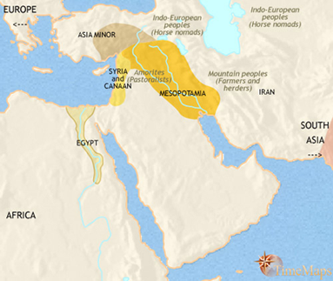
Judaism
Monotheistic religion started by Abraham, the “father” of the Hebrews.
During this time of the Roman Empire, Jews mainly lived in Palestine.
Their holy book is the Torah, and the sacred book of the Hebrews.
They were one of the earliest monotheistic religions and because of this they believed that God would protect them from their enemies.
Roman power spread to Judea, the home of the Jews, around 63 B.C.
At first they remained independent, at least in name. Rome then took control in A.D. 6 and made it a province of the empire.
God had promised that a savior known as the Messiah would arrive and restore the kingdom of the Jews.

Slide 5
Video Break
http://ed.ted.com/lessons/the-five-major-world-religions-john-bellaimey

Slide 6
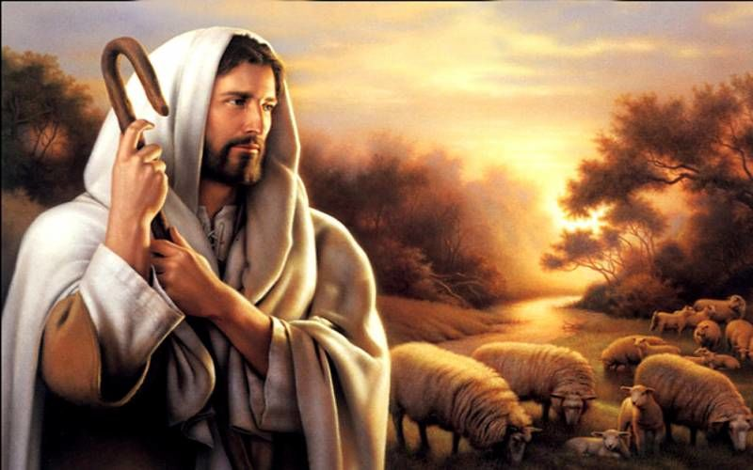
Christianity
Some Jews believed they found this Messiah with Jesus.
Born as a movement within Judaism, Christianity emphasized a more personal relationship between God and people—and attracted many Romans.
At the age of 30, Jesus began his public ministry.
For the next three years, he preached, taught, did good works, and reportedly performed miracles.
Jesus’ teachings contained many ideas from Jewish tradition, such as monotheism and the principles of the Ten Commandments.
He emphasized God’s personal relationship to each human being, the importance of people’s love for God, their neighbors, their enemies, and even themselves. He also taught that God would end wickedness in the world and would establish an eternal kingdom after death for people who sincerely repented their sins.

Slide 7
Jesus’s Death
Jesus’ growing popularity concerned both Roman and Jewish leaders.
When Jesus visited Jerusalem about A.D. 29, enthusiastic crowds greeted him as the Messiah, or king—the one whom the Bible had said would come to rescue the Jews.
The chief priests of the Jews, however, denied that Jesus was the Messiah. They said his teachings were blasphemy, or contempt for God.
The Roman governor Pontius Pilate accused Jesus of defying the authority of Rome. Pilate arrested Jesus and sentenced him to be crucified, or nailed to a large wooden cross to die.

Slide 8
Spreading of Christianity after his death
Some Jews continued to follow Jesus’s teachings after his death. They started referring to him as Jesus Christ.
But some Jews were not convinced that he was the Messiah and continued to practice Judaism waiting for the true Messiah.
Even though Jesus was dead, Christians still posed a problem for Roman rulers.
The main reason was that they refused to worship Roman gods.
This refusal was seen as opposition to Roman rule.
Despite these persecutions, by the 3rd century AD there were millions of Christians in the Roman Empire.

Slide 9
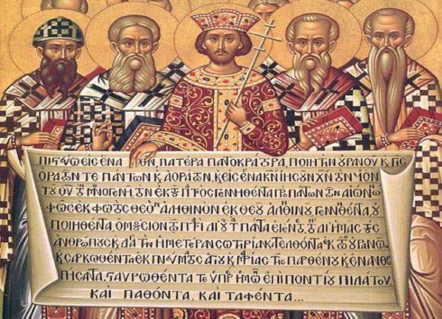
A critical moment in Christianity occurred in A.D. 312, when the Roman emperor Constantine was fighting three rivals for leadership of Rome.
On the day before the battle, Constantine prayed for divine help. He reported that he then saw an image of a cross—a symbol of Christianity. He ordered artisans to put the Christian symbol on his soldier’s shields. Constantine and his troops were victorious in battle. He credited his success to the help of the Christian God.
In the next year, A.D. 313, Constantine announced an end to the persecution of Christians. In the Edict of Milan, he declared Christianity to be one of the religions approved by the emperor.
Video (36:50)

Slide 10
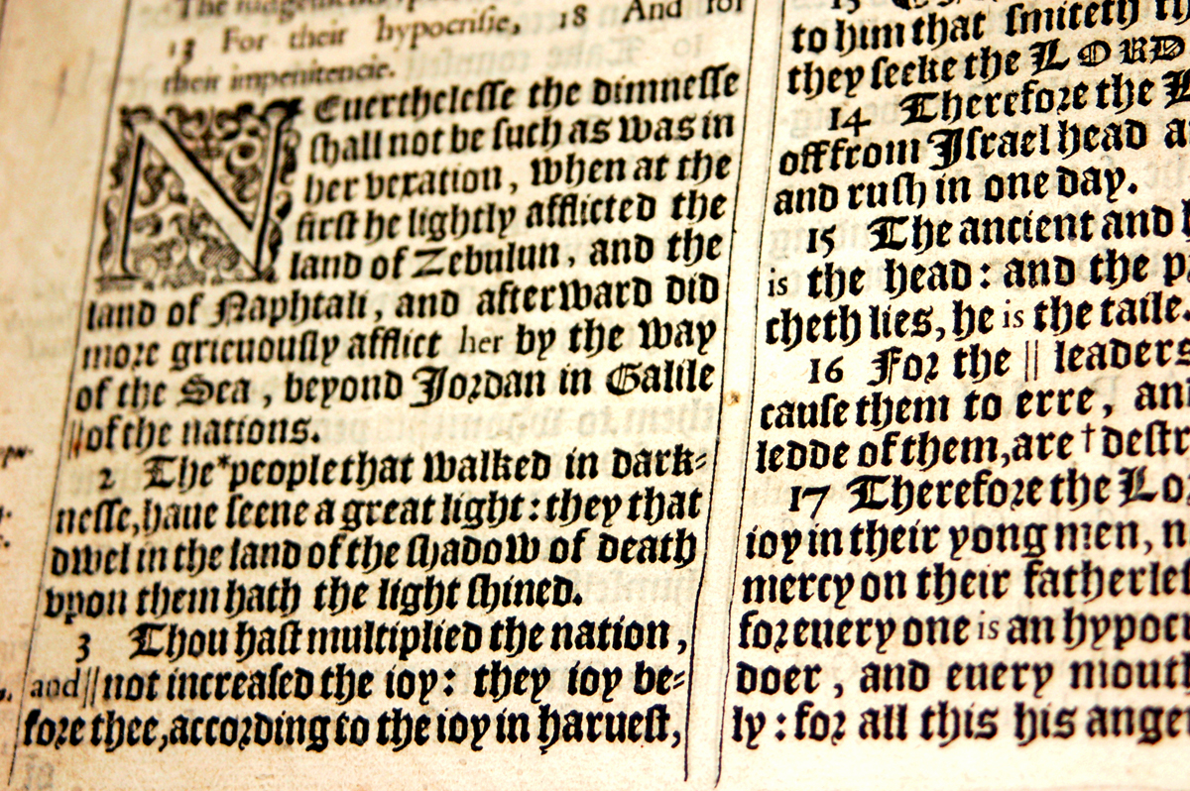
As Christianity was spreading throughout the empire, many clashes arose over interpreting doctrine.
In an attempt to end these conflicts, Church leaders tried to set a single, official standard of belief. These beliefs were compiled in the New Testament, which contained the four Gospels, the Epistles of Paul, and other documents. The New Testament was added to the Hebrew Bible, which Christians called the Old Testament and this would now become the holy book for Christianity- The Bible.

