Slide 1
First 10
Announcements
New Policy: if you were absent come talk to me before going to lunch

Slide 2
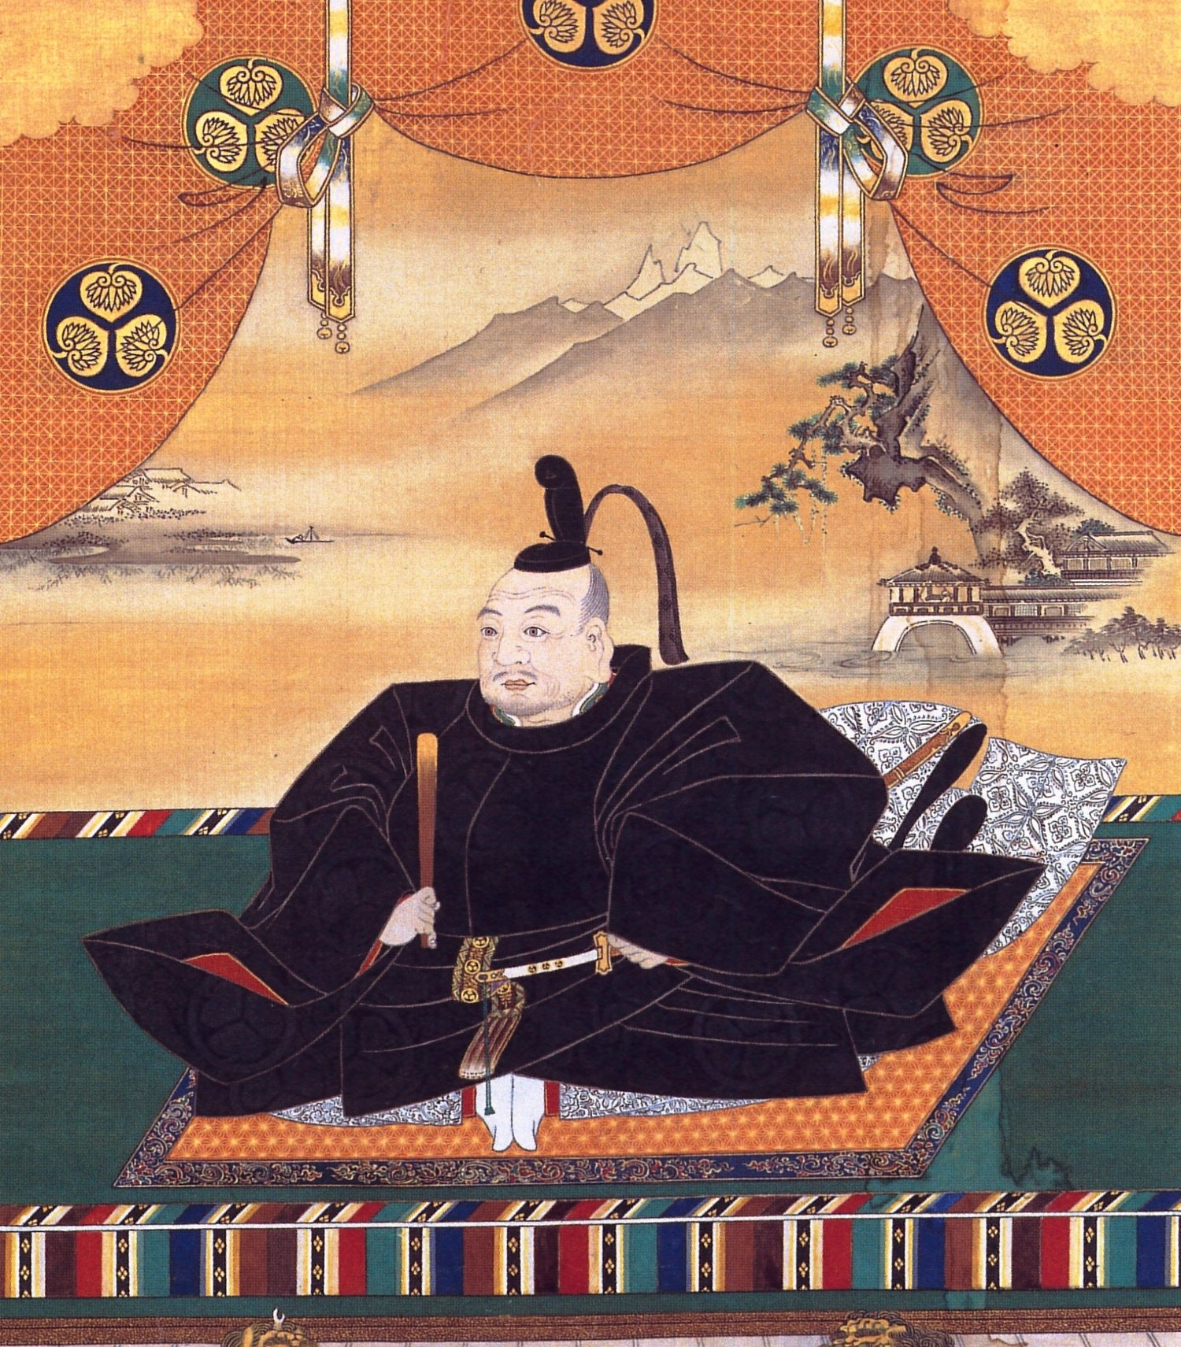
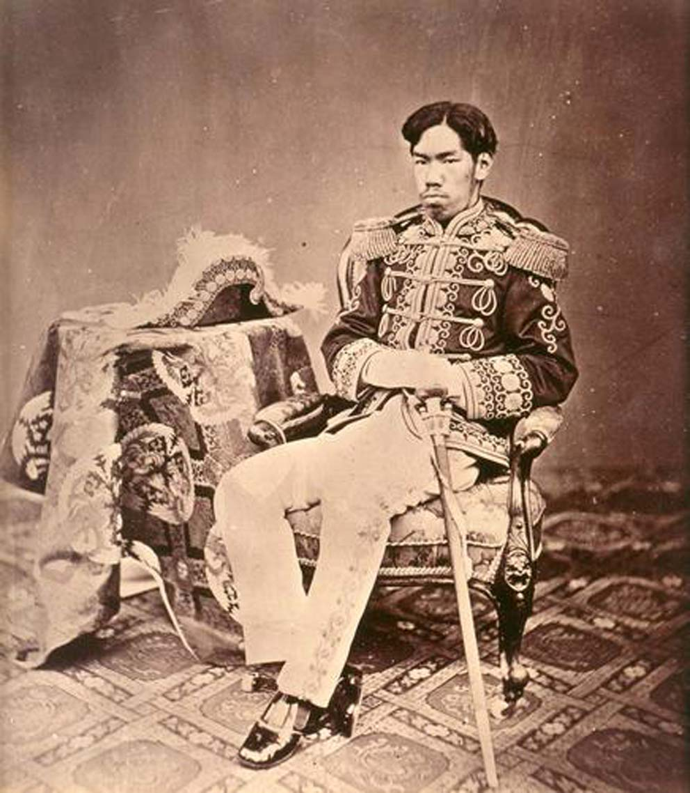
1600
1868
One
Two

Slide 3
Unit 6 Quiz Review
What are the economic motives behind Imperialism?
What are the political motives behind Imperialism?
What does the Europeans use to justify their colonization?
What are the technological motives behind Imperialism? Sig?
Berlin Conference : Who, What, When, Where, Why?
Opium War- cause, events, effects?
Taiping Rebellion- cause, events, effects?
Boxer Rebellion- cause, events, effects?
Tokugawa reign v. Meiji reign

