Slide 1
First Ten
Tutoring after school next Wednesday after school in Room 108 with Ms. Rhinehart. Prior to the tutoring session you must complete the study guide, and you must get that from me today or tomorrow. Remember, these are qualifications to re-take the test.
Islam Video

Slide 2

Use your brain to define or write the description for the following terms…
Allah
Muhammad
Islam
Muslim
Hajj
Sunni
Shi’a

Slide 3
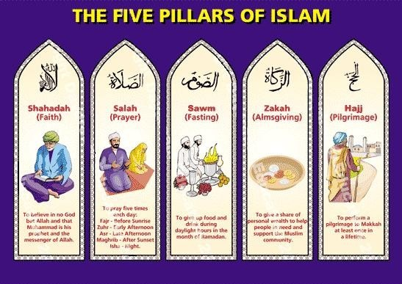
Basics
Islam is the RELIGION and Muslims are the PEOPLE
Only 1/5 of Muslims are Arabs
QURAN (or KORAN): Muslim holy book
Muslims are monotheistic and worship the same one God as Christians and Jews.
Allah, Yahweh, God
MOSQUE: a Islamic place of worship
5 Pillars:

Slide 4
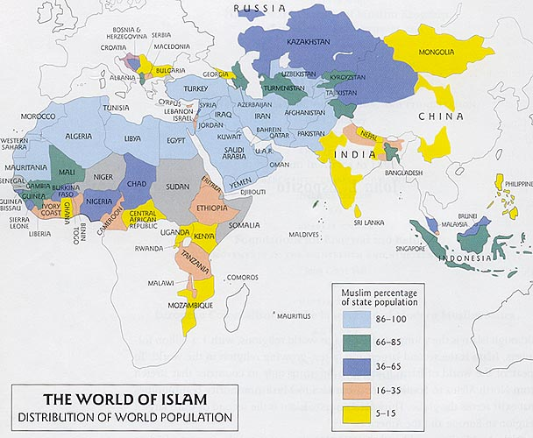
http://www.skidmore.edu/academics/arthistory/ah369/islam_map.jpg
7

Slide 5
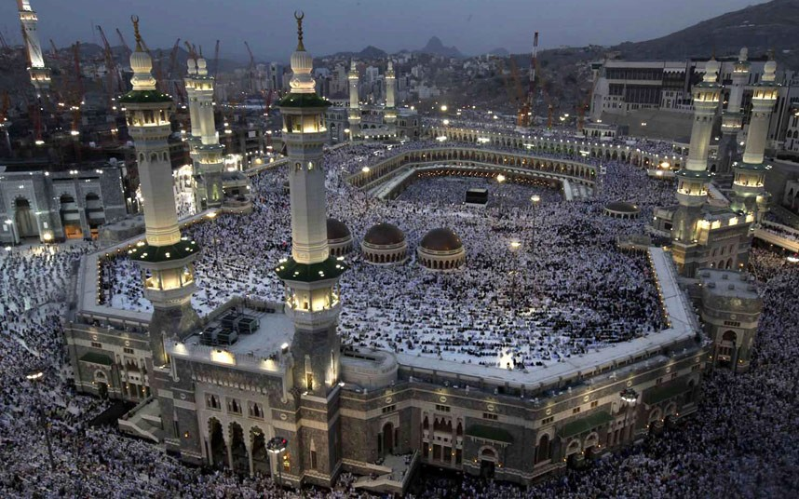
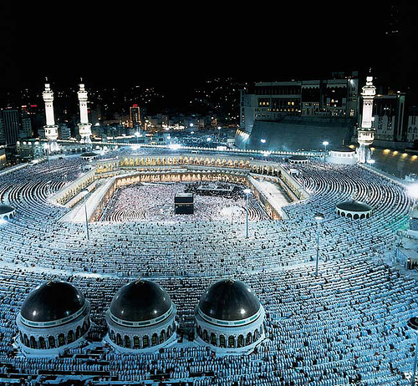
In Mecca during the pilgrimage

Slide 6
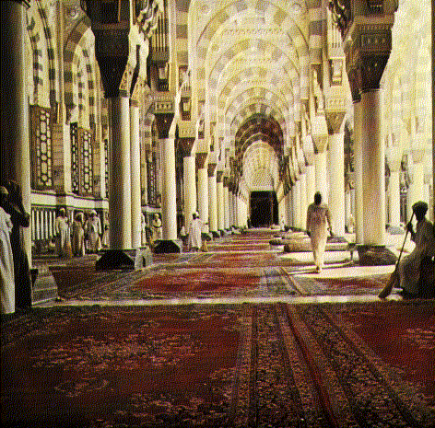
Mosque in Medina, Saudi Arabia
http://islamicbooks.info/H-21-Madh'habs
30

Slide 7
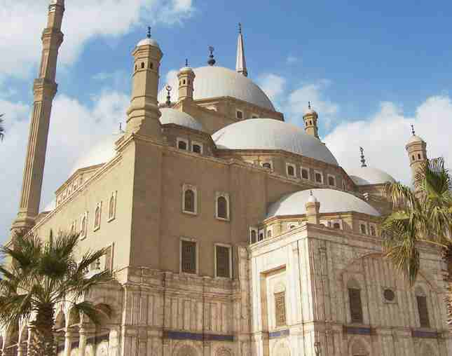
Mohammed Ali mosque, Cairo, Egypt
http://www.solarnavigator.net/geography/egypt.htm
31

Slide 8
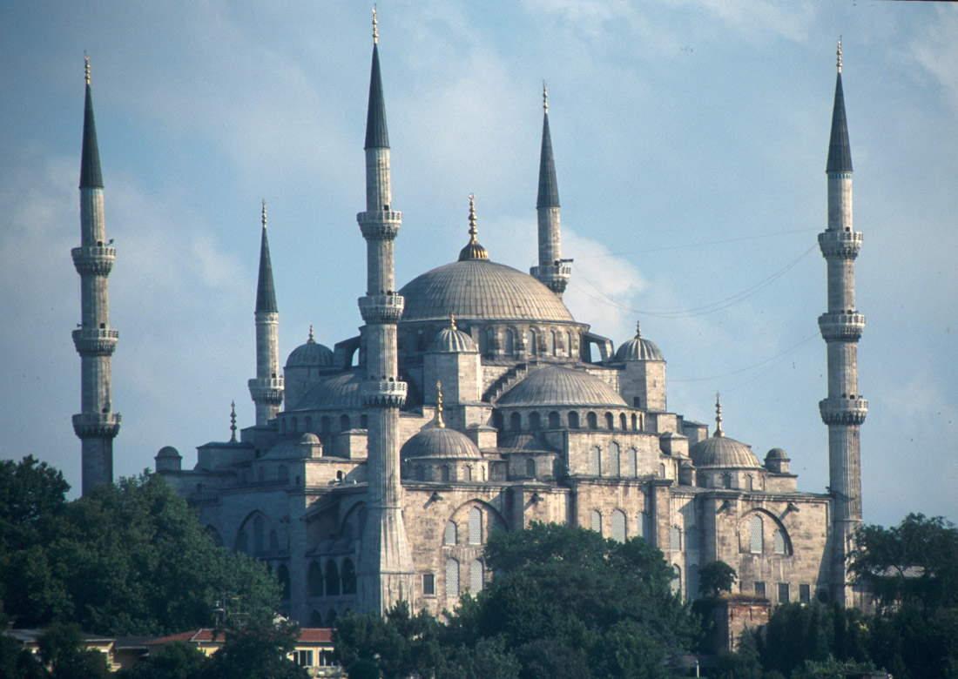
Blue Mosque (Sultan Ahmet Mosque), Istanbul Turkey
http://cs.ua.edu/~greg/personal.html
34

Slide 9
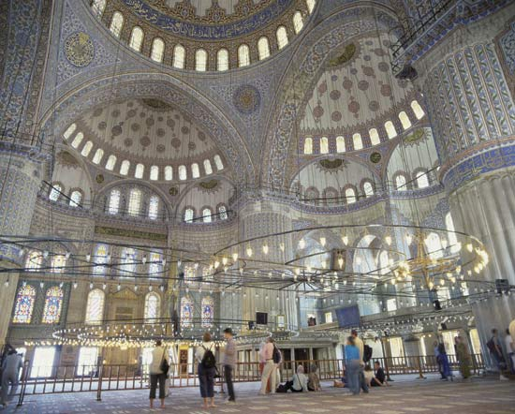
Interior of the Blue Mosque
http://www.britannica.com
35

Slide 10
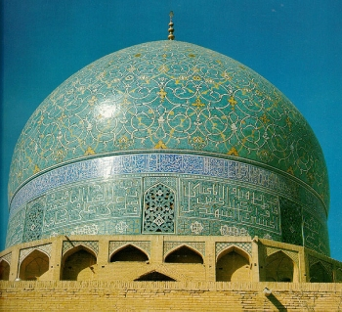
Dome of a mosque, Esfahan, Iran
http://www.perceptivetravel.com/issues/1106/maclean.html
36

Slide 11
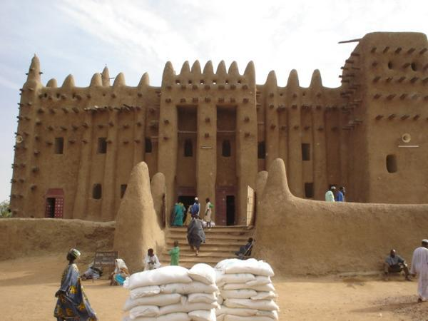
Mosque in Djenne, Mali (West Africa)
http://www.travelblog.org/Photos/17028.html
38

Slide 12
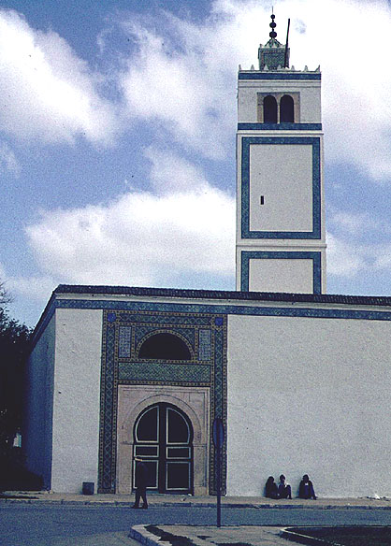
North African mosque
http://www.galenfrysinger.com/
tunis.htm 39

Slide 13
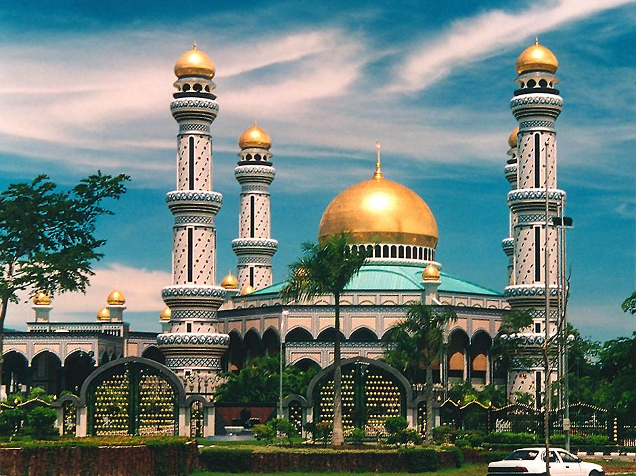
Indonesian mosque
http://www.richard-seaman.com/Travel/Brunei/index.html
40

Slide 14
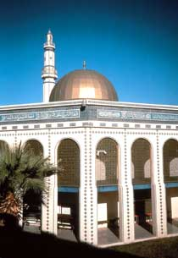
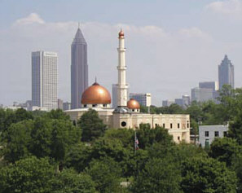
Mosque in Tempe, Arizona
Atlanta!
http://www.4uth.gov.ua/usa/english/society/muslimlife/mosques.htm
43

Slide 15

Relations to other religions?
Acknowledges Adam, Noah, Abraham, Ishmael, Isaac, Jacob, Joseph, Moses, Jesus, John the Baptist, and others as the “the good prophets of God”
Accepts that Mary’s conception is from God’s soul.
Rejects the divinity of Jesus (no trinity).

Slide 16
WRITE DOWN WHAT IS UNDERLINED

Slide 17
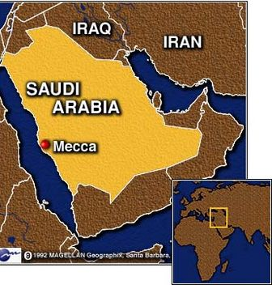
Timeline of Events
571 Muhammad born in Mecca.
610 First revelation in the Harraa cave (27 Ramadan).
613 Muhammad starts to preach; Arabs fear monotheism
622 “Hijrah” or Escape. Muhammad and followers escape prosecution and go to Almadinah (Yathrib). → MEDINA

Slide 18
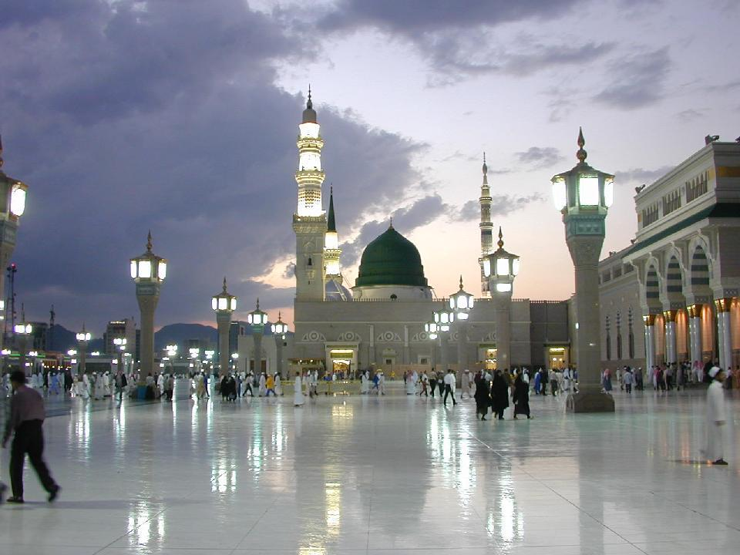
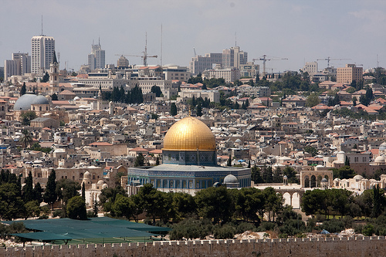
629 Muhammad conquers Mecca peacefully (NO REVENGE)
    destroys idols in Ka’aba.
    brings peace to war-torn Arabia
    Ummah “Community”
632 Muhammad dies in Medina. Unmarked grave (his will)

Slide 19
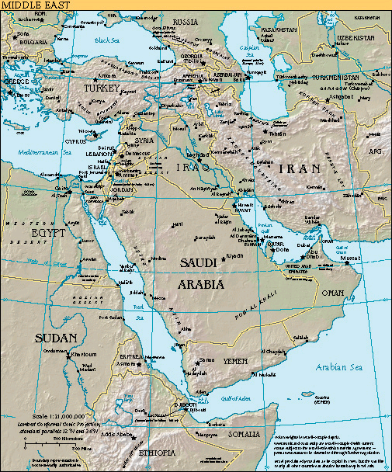
Islam had reached the entire Arabian Peninsula by the death of Mohammed in 632 AD
Extent of Islam at death of Muhammad
Who are “People of the Book”???
Christians and Jews
When conquering territories People of the book did not have to covert and could hold high ranks in the world of Islam.

Slide 20
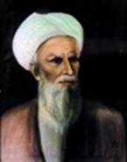
Muhammad’s Successors Spread Islam
What do we do next?
  No named successor
Election: Abu Bakr
  First Caliph “successor” (leader of Islam)
Three more: Umar, Uthman, and Ali
Things start to go wrong = jihad
Expansion occurs after Bakr is dead
By 750 - 6,000 miles – LARGE EMPIRE!
  Muslim success: weak surroundings and persecuted victims, tax
Tolerance for people of the book

Slide 21
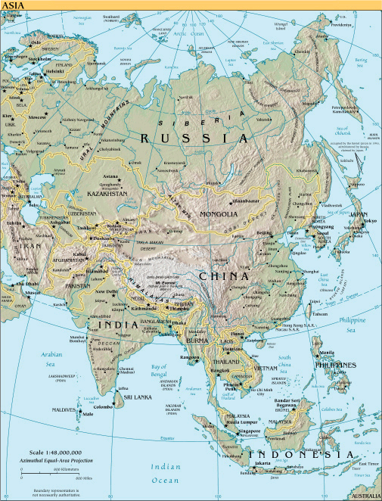
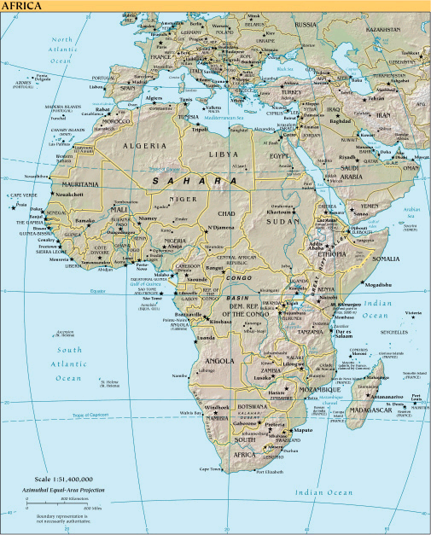
732--100 Yrs after Mohammed

Slide 22
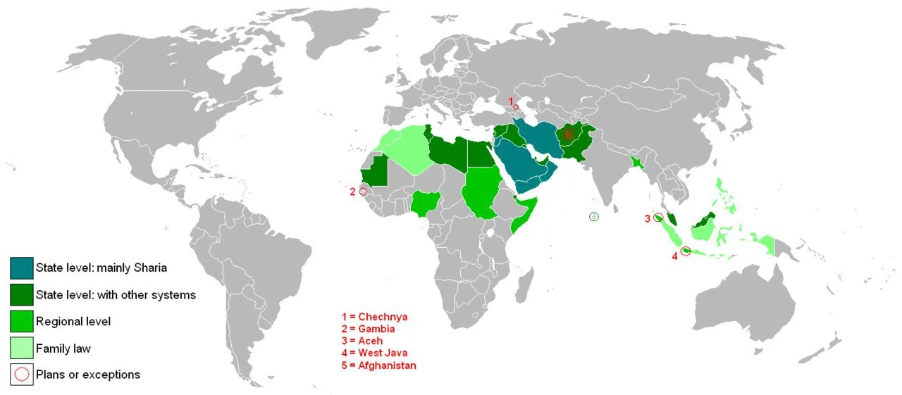
Government
Theocracy
Sharia Law—derived from the Quran and the Hadith
  “body of moral and religious law” from religious prophecy (as opposed to human legislation)

Slide 23
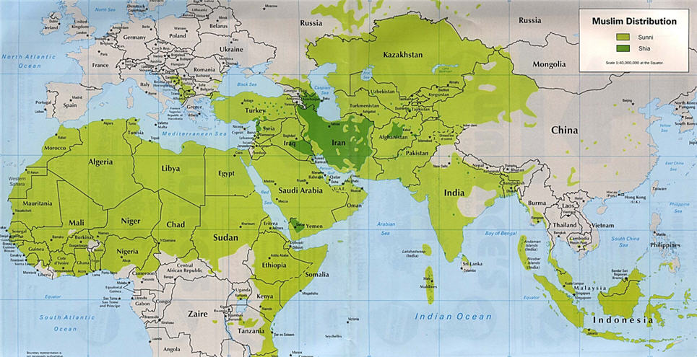
Split of Islam
Sunni- Believed the community should select Muhammad's successor.
  83% of Muslims
Shi’a- Believed a family member, Ali, who was married to Muhammad's daughter, Fatimah should be the first caliph: spiritual head of Islam.
  Today Shi’a is mainly in Iran (90%), Iraq (55%) and Lebanon (~40%)
http://www.cbsnews.com/news/in-detail-sunnis-vs-shiites/

Slide 24
Ibn Battuta Document Analysis

Slide 25
Ibn Sina Reading and Timeline

