Slide 1
The New Imperialism
19th-20th century

Slide 2
Frist 10
Please work on the Colonization of Africa sheet that you picked up
If you were absent yesterday come see me

Slide 3
Why did Europeans Colonize?
Industrialization
European nations needed resources to support consumer markets/industry.
The ability to produce vast quantities of goods meant that countries also needed vast amounts of ppl. to buy the manufactured goods.
PRE-Colonization
Africans were ethnically/linguistically divided (1,000 +)
Europeans were unfamiliar with the land and usually only settled on the coast.
Prior to 1880 only 10% of Africa was colonized and it was in the coastal area.
SO….How do we go from 10% to this…..

Slide 4
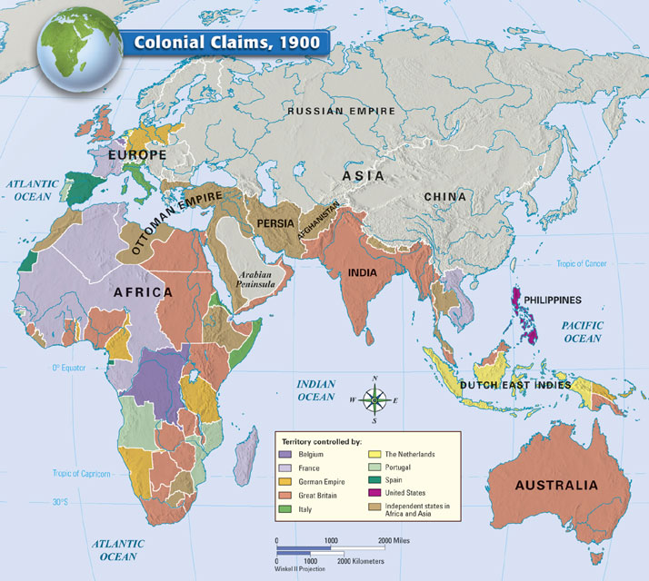

Slide 5
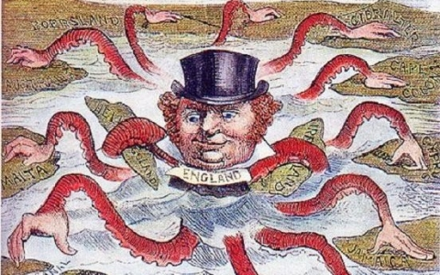
Definition
Imperialism is a policy in which a strong nation seeks to dominate other countries politically, economically and/or socially.
Empire building
Question: Who is the Imperialist power in the cartoon? What countries are under its control?
Notes:
The man is John Bull, an imaginary figure who is a personification of England similar to the American ‘Uncle Sam’. He appears in many political cartoons of this period.

Slide 6
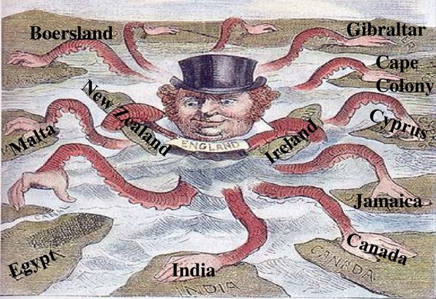

Slide 7
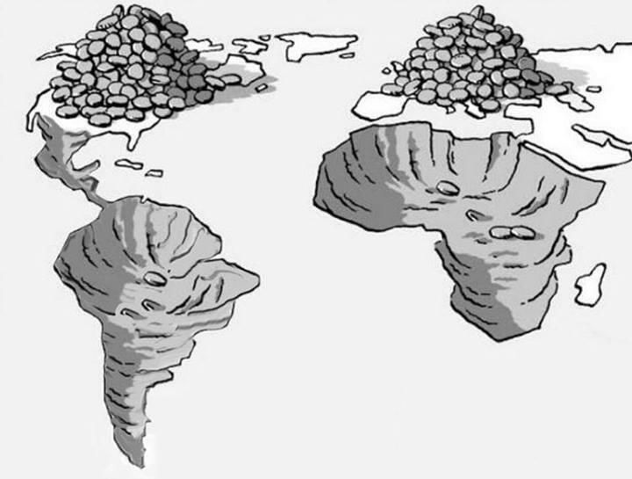
Economic Motives Behind Imperialism
The need for raw materials to fuel industrialization
New markets for industrial products
Question: what does this image suggest about American and European Imperialism?
Notes:
This is titled “Gold Diggers”

Slide 8
Political Motives
Competition among the major world powers to gain dominance pushed them to expand their political holdings.

Slide 9
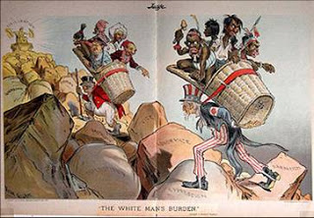
Social/Ideological Motives
Religion: belief in the Christian missionary work; conversion was coerced
Social Darwinism: the belief that more advanced people were superior to other people (racist)
https://www.youtube.com/watch?v=URfF6Wtyc_0
Notes:
John Bull ( England) and Uncle Sam ( U.S.) carry their “burden” to the top of the mountain; their self-proclaimed superiority was seen as a responsibility to those less fortunate peoples. This condescending, racist view was widely accepted among white Europeans and Americans.

Slide 10
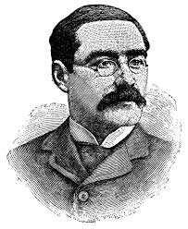
“The White Mans Burden” by Rudyard Kipling Kipling’s Hymn to U.S. Imperialism 1899
White Man’s Burden
“Take up the White Man’s Burden,
Send forth the best ye breed,
Go bind your sons to exile,
To serve your captive's need;
To wait in heavy harness
On fluttered folk and wild,
Your new-caught sullen peoples,
Half-devil and half-child.”
Notes:
Belief that it was the duty of the white man to help civilize weaker nations.

Slide 11
Technological Motives
Technological advances made it possible to travel where they couldn’t previously (Steam engine made rapid river travel possible)
Advanced weapons (Maxim rapid fire gun)
New drugs to combat diseases (quinine)
Notes:
These advances were especially significant to the colonization of Africa which allowed the Europeans to penetrate to the interior where once they were confined tocoastal areas.

Slide 12
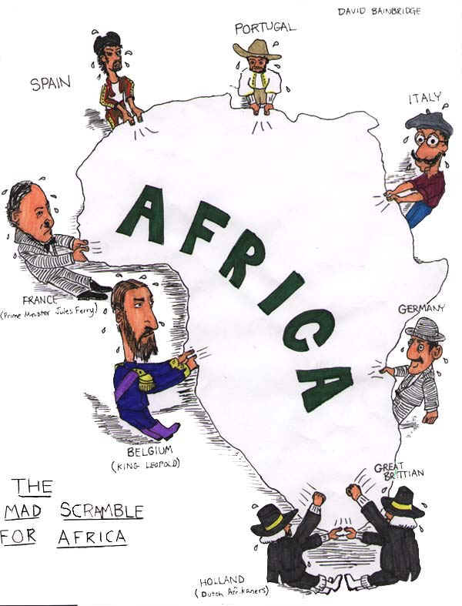
Berlin Conference
Europeans now held items to help them conquer Africa (weapons, travel, $, meds, and a lack of unity in Africa)
As competition for Africa grew, European powers feared war amongst themselves.
Berlin Conference (1885/6)
14 nations (all European)
NOT a single AFRICAN leader
“Notify and Prove” you could handle the territory.
https://www.youtube.com/watch?v=OJe1W_HIWmA

Slide 13
Legacy of Imperialism in Africa
Positive
Humanitarian efforts (Hospitals/Schools)
Lifespan & Literacy rates Increase
Increase in transportation & communication in Africa
Negative
Lost control of land/freedom
Death (small pox, cruelty, and famine)
POLITICAL/ECONOMIC LEGACY

