Slide 1
Fist Ten
The concept of a revolution rocked the world of monarchies and created new forms of government for the world to follow.
English Revolution - 1689
American Revolution - 1776
French Revolution - 1789
Haitian Revolution – 1791
Latin American - 1820
Why do you think the Haitian revolution followed the French?
What was the cause of these revolutions? (Hint: Think REASONABLY)
Prior to leaving here today you must be able to understand the relationship between the following: Absolutism +Enlightenment = Revolutions = Democratic forms of government

Slide 2
English Revolution
AKA: Glorious Revolution

Slide 3
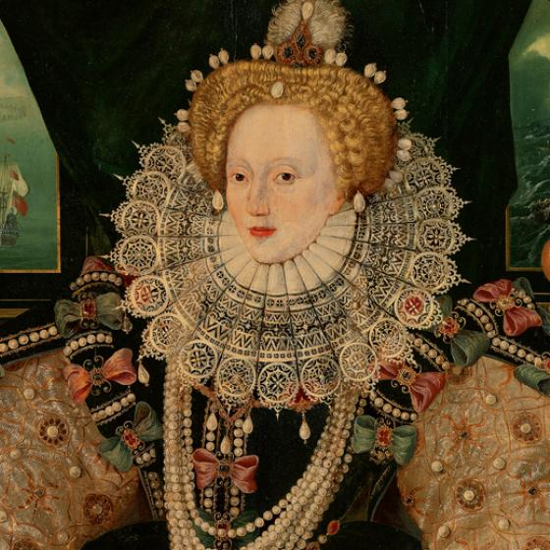
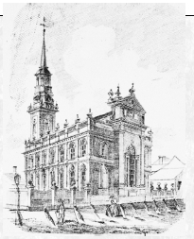
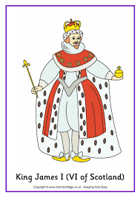
The road to revolution: England
Queen Elizabeth died with no children, 1603. End of the Tudor dynasty.
James (her cousin, King of Scotland) becomes king of England : James I ( The Stuart dynasty)
Puritans didn’t like James; he wouldn’t encourage their purifications of the Catholic Church
Parliament didn’t agree with him either, James always
wanted more money.
Problems: Religion and Money

Slide 4
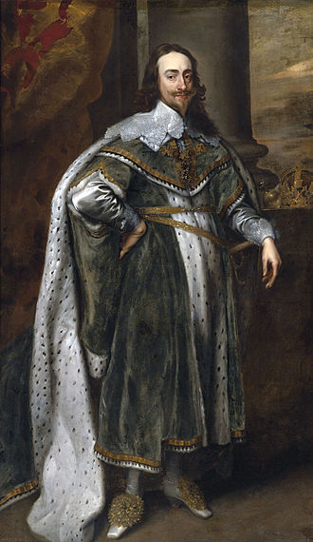
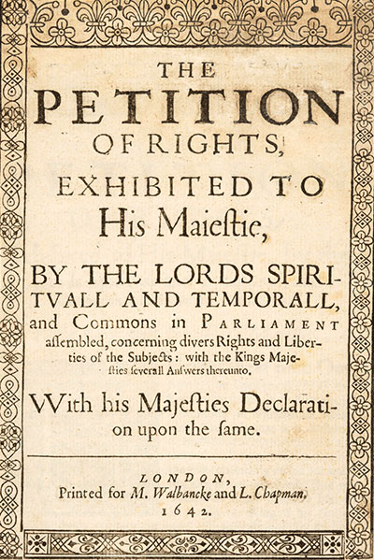
Problems with Parliament
Charles I ( James’s son) becomes king when James dies.
Always wanted more MONEY. If Parliament didn’t give it to him, he disbanded Parliament
Parliament forces Charles I to sign Petition of Rights, 1628:
No imprisonment w/o just cause
No new taxes w/o consent of Parliament
No housing soldiers in private homes
No martial law in peacetime
Challenged idea of Divine right
King was NOT above the Law
He signed it but ignored it

Slide 5
Civil War
Those who support King Charles I:
The Cavaliers
Those who support Parliament/Puritans:
The Roundheads

Slide 6
And the winner is…. The Roundheads!
Charles I put on trial and executed.
New Gov. under Oliver Cromwell is Republic, Commonwealth in theory
Cromwell becomes military dictator

Slide 7
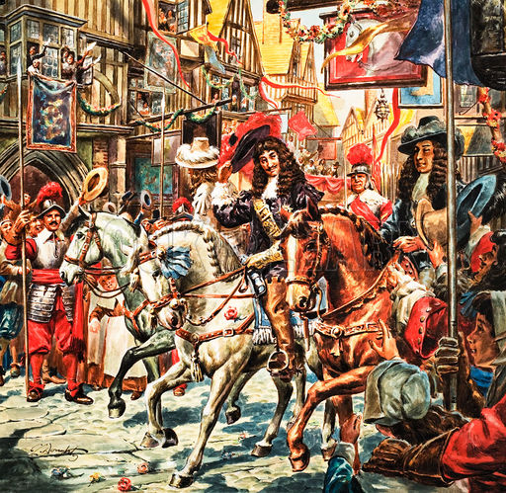
Restoration 1660
Cromwell dies and most people are happy to be rid of the military dictatorship.
Parliament decides they want a King back. They ask Prince Charles (King Charles I’s son) to take the thrown.
Much celebration; Charles II known as the Merry Monarch. His reign is called the Restoration.
Parliament increases their power over the King.
Charles II dies without a son in 1685.
His brother James becomes King James II

Slide 9
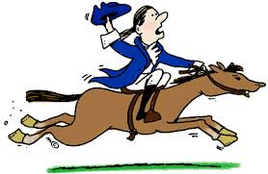
GLORIOUS REVOLUTION 1688-89
Causes:
James II was Catholic & had absolutist policies
Nobody really liked that but they figured they could control him
He soon offends everyone with his “Catholic ways“
Appoints Catholic officials
Violates laws
James II had a son. Protestants (majority of parliament) were afraid his son would want to spread Catholicism.

Slide 10
Bloodless Revolution
Parliament overthrows James II. They invites James II’s son-in-law, William of Orange, and Mary who is James’s daughter, to INVADE.
James II flees to France.

Slide 11
William and Mary
Effects:
England is no longer an Absolute Monarchy
Constitutional Monarchy/ Limited Monarchy
The monarch power comes from the Constitution.
Monarchs power is limited, rule with consent of Parliament
English Bill of Rights, 1689
Parliament and Monarch govern together

Slide 12
English Bill of Rights
Drafted in 1689
Limits the royal’s power
Listed what the rulers cannot do
No suspending of Parliaments laws
No levying of taxes w/o grant from Parliament
No interfering with freedom of speech
This creates a Constitutional Monarchy

Slide 13
Take a Break
Stand up and stretch
https://www.youtube.com/watch?v=A_56cZGRMx4

Slide 14
American Revolution

Slide 15
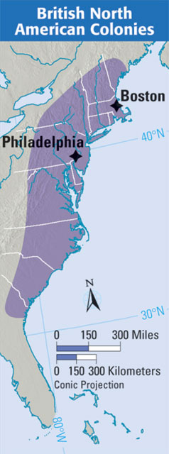
AMERICAN REVOLUTION
1776; colony of the British Empire
Causes:
French & Indian War
Proclamation Line of 1763
Lack of self-governance
Colonies could not sell many goods to any country but Britain.
High taxes on imports
Series of Acts- Stamp, tea, Intolerable

Slide 16
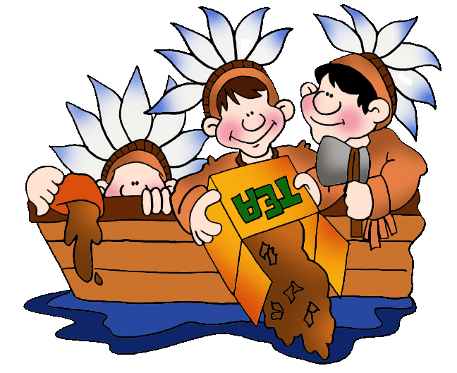
American Revolution
Events:
Boston Tea Party 1773: Protest against the heavy import tax on tea
First and Second Continental Congress
Lexington and Concord, “shot heard round the world”; 1775 first shots of the Revolution

Slide 17
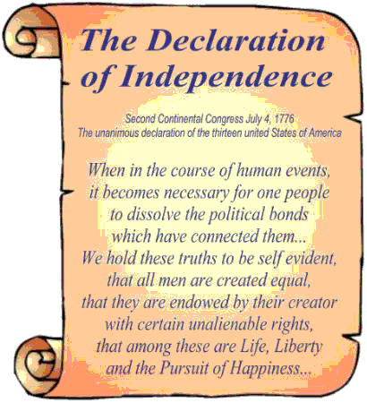
Declaration of Independence
Using ideas of the Enlightenment, colonial leaders write the Declaration of Independence, 1776
Social contract
Natural rights, John Locke
Consent of the governed

Slide 18
American Revolution
Great Britain was not about to give up that easily.
What enabled the rag tag army of the colonies to defeat the Great British Empire?
Overconfident British made mistakes
Money and help from France, Louis XVI wanted weaken Britain
Washington’s leadership & motivation
Geography

Slide 19
Effects of American Revolution
INDEPENDENCE!
The US Constitution & the Declaration of Independence: established on enlightenment ideas & influences other countries
It puts the French in debt
Inspires the French who sought reform in France

Slide 20
Last 10
Kahoot

