Slide 1
First Ten
Sit quietly with your candy and wait on directions.
New seating Chart
Turn in your village … :
Make sure your name is on it. Make sure you have named your ideal city.
Staple your “Design a city worksheet on top of your city illustrations .
Turn it into the basket in the front of the room.

Slide 2
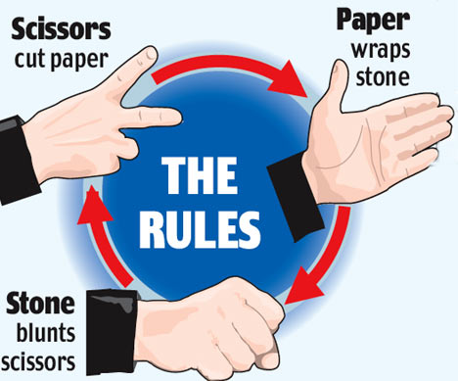
Activity
Rock Paper Scissors

Slide 3
Version A
Two opponents face off at one time
Each will decide how much candy to bet (it needs to be the same amount for each person)
The winner keeps the candy
When you lose all of your candy, return to your seat

Slide 4
How did you feel at the start of the game?
How do you feel at the end of the game?
Do you think this game is fair?
What could Ms. Borduin do to make the game more fair?

Slide 5
Version B
Two opponents face off at one time
Each player must bet the same amount
Regardless of who wins you keep your candy

Slide 6
Those that were wealthy in the previous version, how do you feel about this version?
Those that went bankrupt in the previous version, how do you feel about this version?

Slide 7
Effects of Industrialization
Shifted world balance of power. How?
Increased competition in industrialized nations and poverty in less developed nations.
Industrialized countries viewed poor countries as markets for their manufactured products
Industrialization gave Europe tremendous economic power. How?

Slide 8
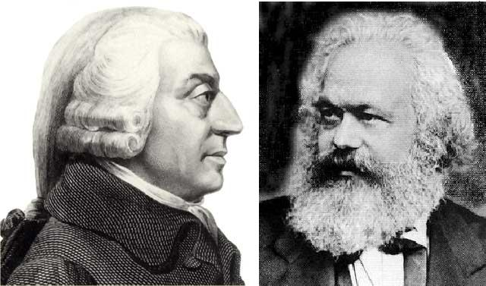
Capitalism v. Communism
Capitalism
Private sector
No control “laissez faire”
Adam Smith/Wealth of Nations
Make money!
Communism
Public Sector
Government has complete control of business
Karl Marx/Communist Manifesto
Provide for the people

Slide 9
What type of government is version A?
What type of government is version B?

Slide 10
Version A Recap...
The game (capitalism) started with an unequal distribution of candy (wealth). A few students (the wealthy) had far greater resources than the rest of the class (the working class).
A few students were able to prosper during the game (capitalism). Their advantage made it virtually impossible for the rest of the students (working class) to succeed in the game.
Those who succeeded (the wealthy) in the game support it. Those who did not succeed (the working class) pointed out its unfairness and generally wanted to change the game (change the system).

Slide 11
Version B Recap…
Ms. Borduin (government) collected the candy (wealth) and redistributed them equally (socialism). Thus, no student had more candy (wealth) than another (resulting in a classless society).

Slide 12
What is Socialism?
Idea that government can be capitalist while also taking care of its people:
Government regulations (laws to regulate business)
Healthcare
Provide for the population

Slide 13
Class Work
Communism/Capitalism Worksheet

Slide 14
“It is the highest impertinence and presumption… in kings and ministers, to pretend to watch over the economy of private people, and to restrain their expense... They are themselves always, and without any exception, the greatest spendthrifts in the society. Let them look well after their own expense, and they may safely trust private people with theirs. If their own extravagance does not ruin the state, that of their subjects never will.”
The Wealth Of Nations, Book II, Chapter III, p.346, para. 36. (Adam Smith)

Slide 15
Capitalism
“An economic system in which money is invested (capital)with the goal of making more money (profit).”
The Wealth of Nations - 1776 – Adam Smith
Free-market Capitalism
Restrictions on businesses stifle growth
An “invisible hand” would guide the economy
Laissez-faire – gov’t should be hands-off

Slide 16
Communism
“An economic system in which all means of production – land, factories, railroads, and businesses – are owned by the people (→ Government) , private property does not exist, and all goods and services are shared equally”
Karl Marx - The Communist Manifesto 1848
Predicted that the workers would someday REVOLT against the wealthy
Believed capitalism would destroy itself
Developed into Marxism
Eventually a complete form of Socialism would arise
Total public ownership of means of production
No private Property
A classless society

Slide 17
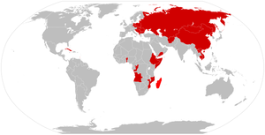
Communism between 1979-1983

Slide 18
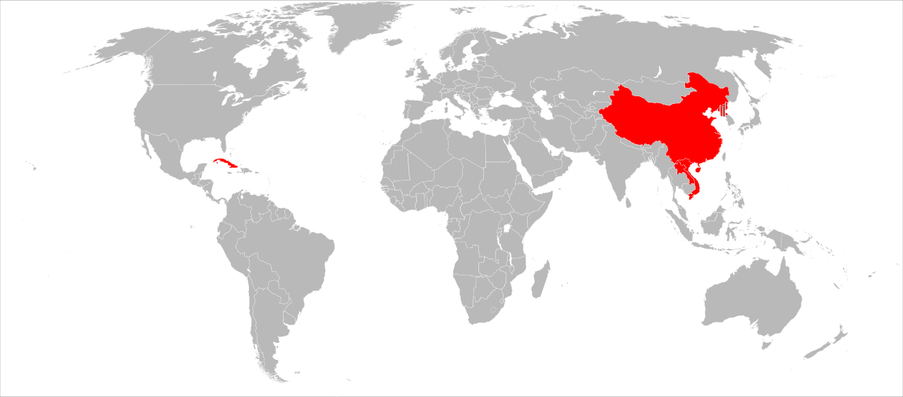
Communist countries 2017
China, Cuba, Cambodia, Laos, Vietnam, and North Korea

