Slide 1
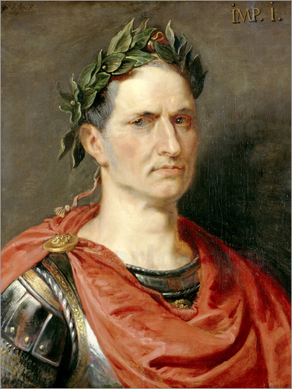
Cold Case: Julius Caesar

Slide 2
First 10
Review homework
Read background

Slide 3
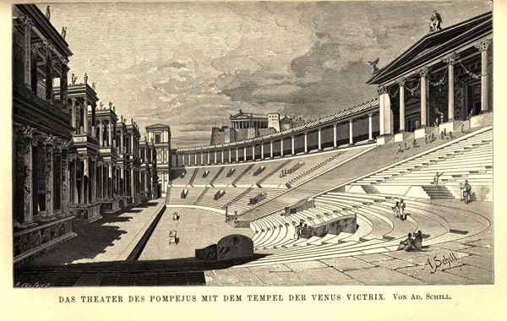
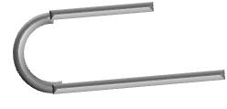
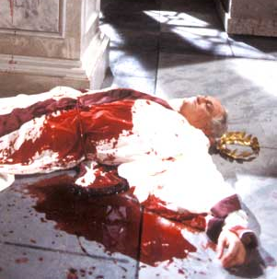
COLD CASE FILES
CRIME REPORT
16 March, 44 BC
On March 15, 44 B.C. Gaius Julius Caesar died of multiple stab wounds to the chest. There were many witnesses to the attack but few concrete details could be worked out. We know there were many senators involved in the attack but all fled the scene. The exact motivation and number of attackers is still unknown.
There are three options to consider:
- The senators assassinated Caesar due to jealousy of his fame.
- The senators assassinated Caesar because they thought he was destroying Rome by making himself emperor.
- Caesar allowed the assassination to happen because he wanted to die a memorable and heroic death.
This case remains unsolved.

Slide 4
Suspects

Slide 5
Game Plan:
3 students per exhibit
Work quickly and Be respectful when investigating
Spend no more than 6 minutes per exhibit
Once finished, sit down and fill out the Investigation Report & Indictment
Homework: Caesar’s achievements

Slide 6
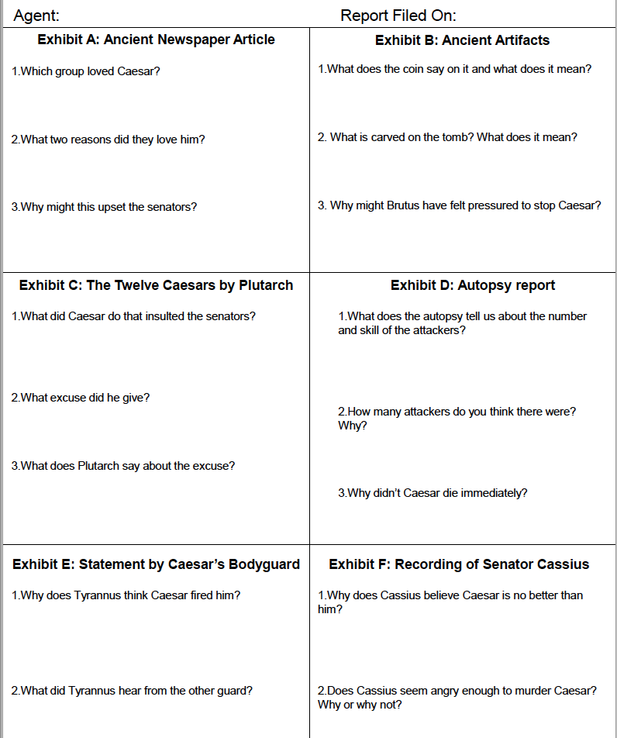

Slide 7
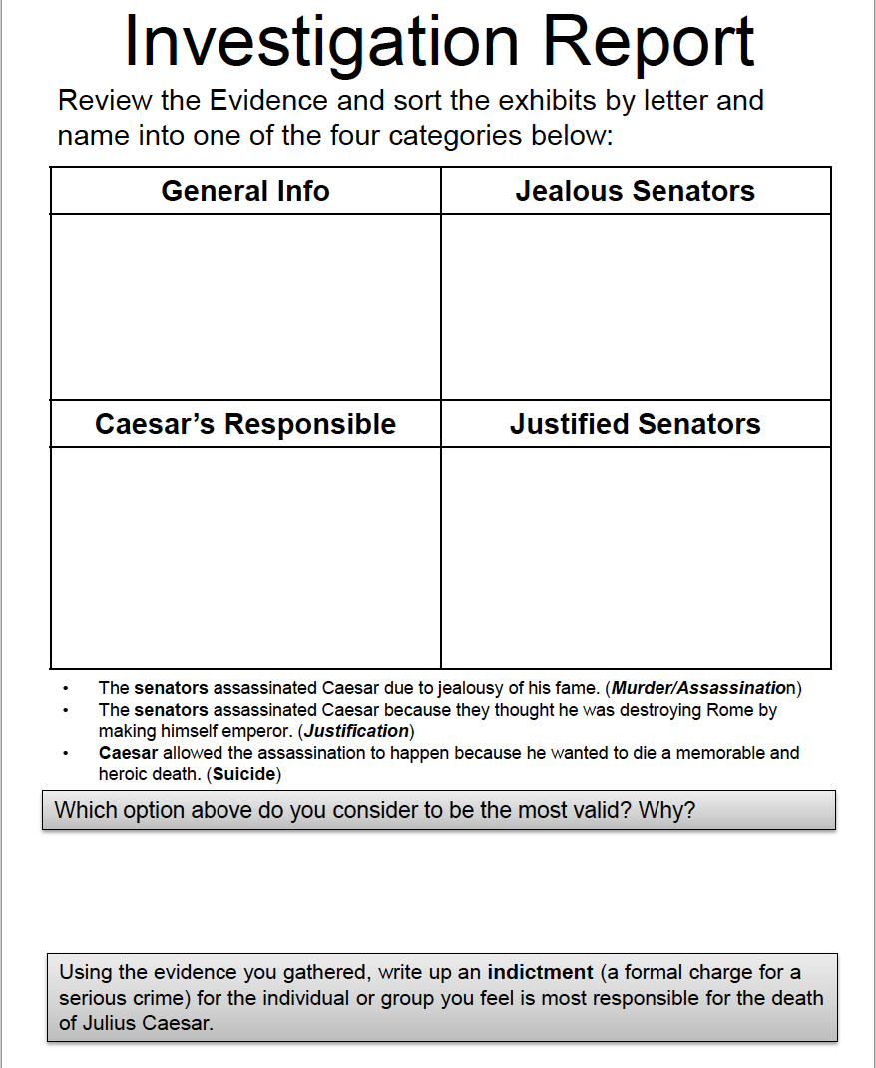

Slide 8
Indictment
Now that you have seen all the evidence write an indictment.

Slide 9
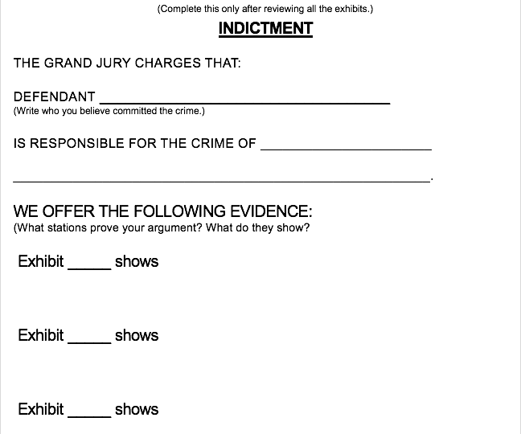

Slide 10
Groupings
Group 1 | Group 2 | Group 2 | Group 3 | Group 4
Imani | Chris | Natalie | Stephany | Austin
Matthew | Ambrea | Behzad | Nick C. | Jeanine
Brij | Alyssa | Raph | Ryan | Daniella
Group 5 | Group 6 | Group 7 | Group 8
Josh | Cole | Heaven | Taylor
Diego | Mary Grace | Kayla | Momina
Nathan | Nic G | Mohammed | Jessica
 | Sophie

Slide 11
Exhibit E : Medical Examiner

Slide 12
Exhibit H: Dr. Burzstajn Interview

Slide 13
Exhibit F : Transcript
Sound file click here

